Slide 1
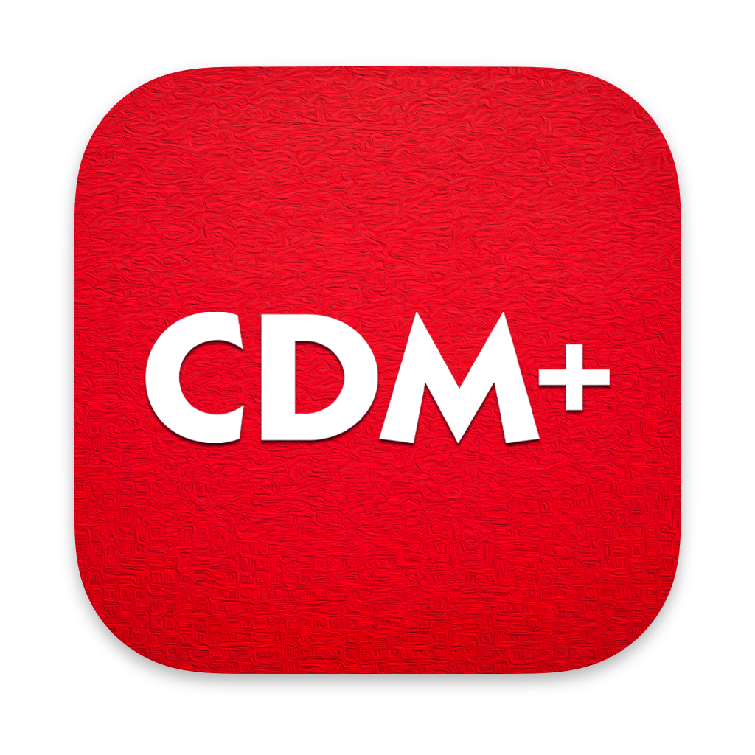
2021 Duluth CDM+ Training
October 13, 2021
Alex Clay and Steve Hansen, Suran Systems, Inc.

Slide 2
Welcome!

Slide 3
About Suran
Founded in 1987 by Randy and Sue Clay (Sue + Randy = Suran)
Thousands of clients throughout the US and beyond
Primarily serve the faith-based and non-profit market
Privileged to have a relationship with the Diocese of Duluth back to 1994
We offer a customized version of CDM+ that includes several features specific to the Diocese
We’ve held a training similar to this (in-person) every 3 years since at least 2006

Slide 4
Presenters
Alex Clay
Employed at Suran since 1997 (Sue and Randy’s son)
Worked in development from 2001 through 2020
Moved into the CEO position in 2019
Presented and trained at countless conferences, with clients, and in regional settings
Resides in Lexington, KY
alex@suran.com

Slide 5
Presenters
Steve Hansen
Employed at Suran since 2005
Works in sales and data conversions
Former experience with his own family business providing Church Management software
Has attended all Duluth Trainings since 2006
Based in St. Paul, MN
steve@suran.com

Slide 6
About This Training
2.5 days of concentrated training
Cover core features in CDM+ Desktop, CDM+ Mobile, and Engage
Sessions will be recorded
duluth.suran.com for schedule and training manuals

Slide 7
Going Virtual
Use the Zoom chat to ask questions
Most sessions are 75 minutes
Get up, stretch, move during breaks
Please close your mail, put your phone on silent, etc. to help focus
Open Q&A at the end of each day - let us know if you want to use that time

Slide 8
CDM+ Overview

Slide 9
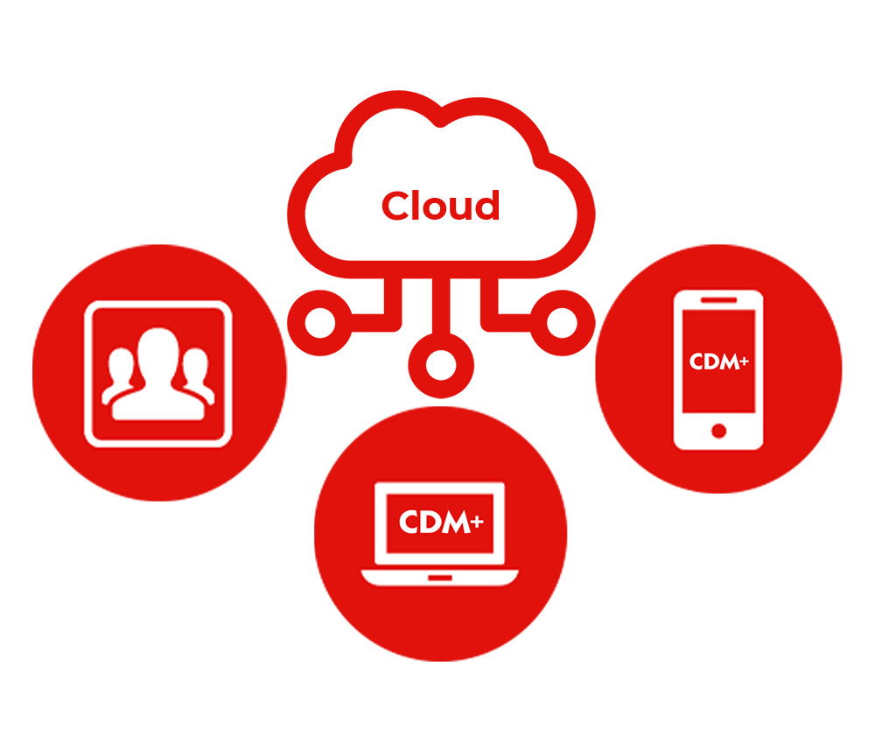
CDM+ Software Suite
https://www.cdmplus.com/desktop-web-and-mobile-platforms/

Slide 10
Right Tool for the Job
CDM+ is Cloud Computing
CDM+ Desktop offers powerful, robust database software (e.g. accounting operations and reporting)
CDM+ Mobile provides fast, purpose-built data access (e.g. attendance entry, check-in, and receipts)
Engage provides a familiar, online experience for members and visitors (e.g. online giving and directories)
Hosted data in our managed cloud connects and integrates everything

Slide 11
The Key is Integration

Slide 12
CDM+ Programs
Regional
Event Registration
Roommate Facilities Manager
Membership & Attendance
Check-In/
Check-Out
Contributions
Accounting & Payroll
Sales Orders

Slide 13
Common Features
All programs manage different, but connected, information
The tools and features throughout are the same
Skills working in Membership can apply to Contributions, Check-In/Check-Out, etc.
Learning common tools (window interfaces, reports, notices, finds) will turn you into a power user
Use this training to learn how to use the system and discover what’s possible to get maximum value

Slide 14
Getting Help
help.suran.com
support@cdmplus.com
800-633-9581 for support
Conferences and colleagues

Slide 15
Technical Note
We’ll be using a CDM+ 12.0 beta today
We expect this beta to be generally available next week
The general release will be before year end
CDM+ 12.0 will be required for any tax work and payroll in 2022
Review the system requirements (https://help.suran.com/cdm/latest/installing-cdm+/cdm+-12-0-system-requirements-fall-2021)
Just in case we run into glitches we can jump back to CDM+ 11.2 (the current published version)

Slide 16
Let’s get started in CDM+ Membership!

